Slide 1
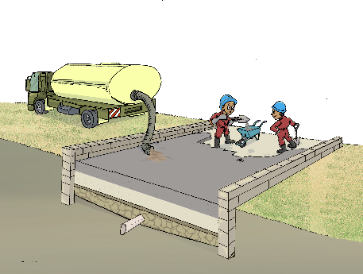
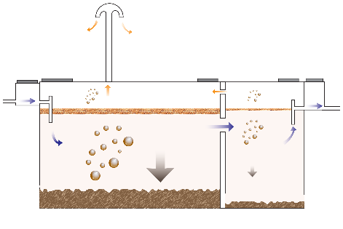
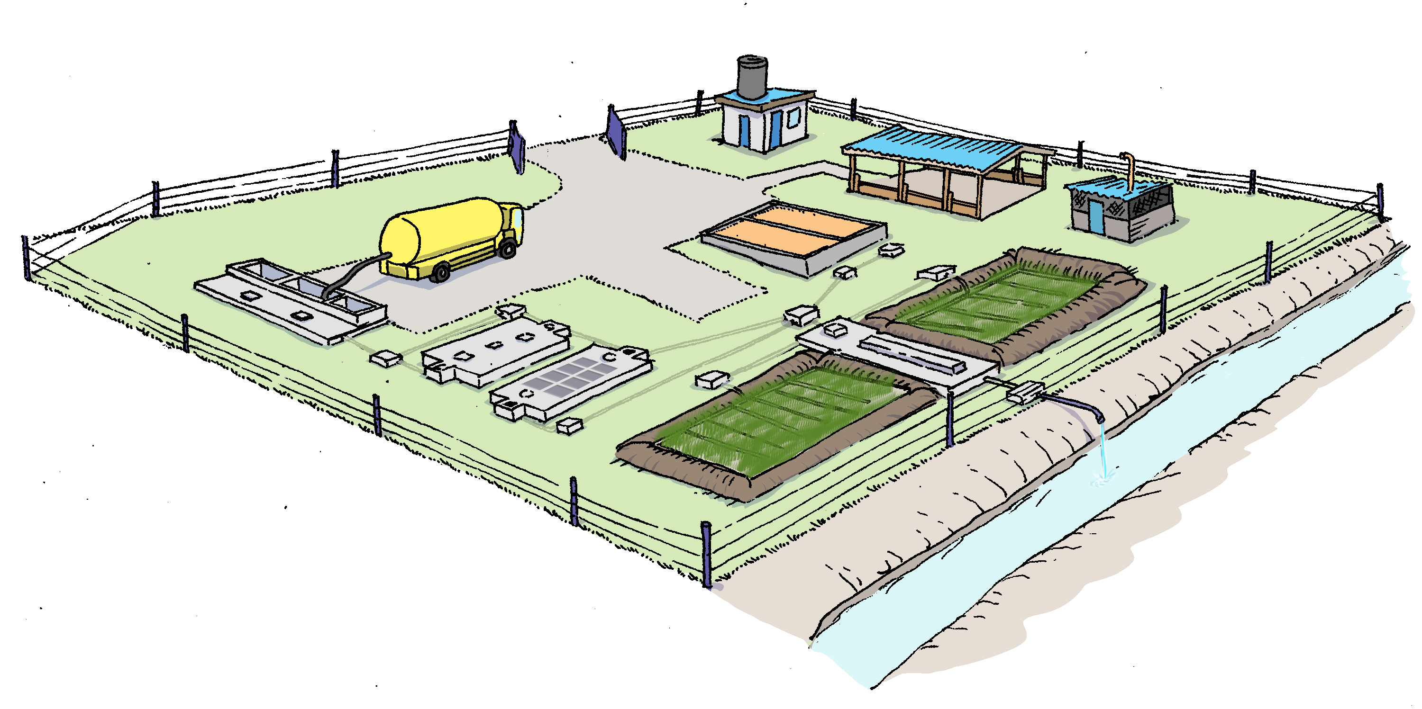
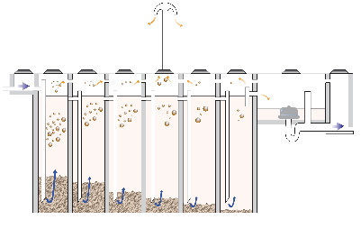
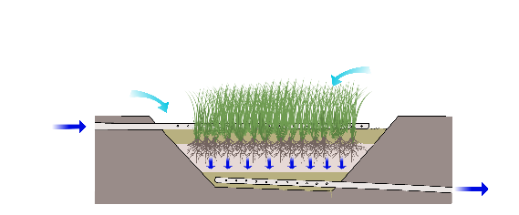
DTF TREATMENT PROCESSES

Slide 3
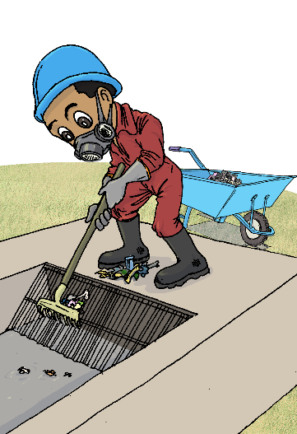
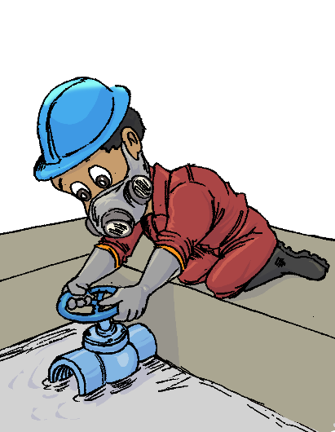
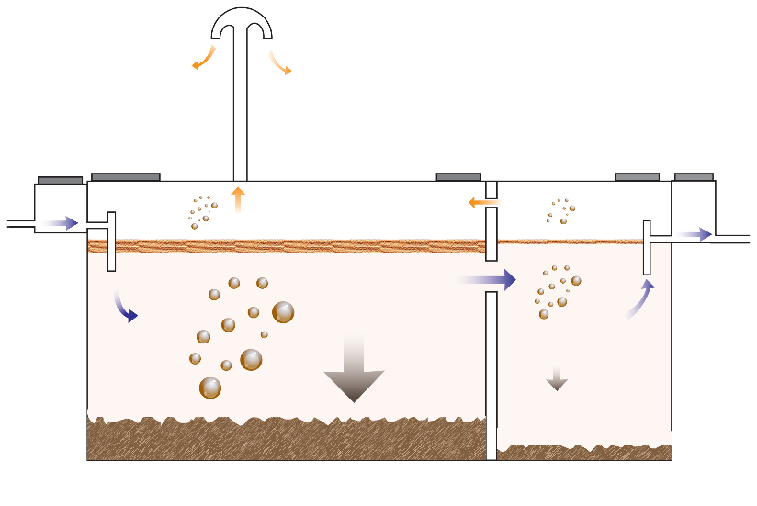
TREATMENT PRINCIPLES OF A DTF
1
Receiving Bay / Balancing Tank (Preliminary treatment)
Entry point of the faecal sludge
Mechanical treatment
Receiving bay: the inflow is screened and the coarse material is removed
Balancing tank: the faecal sludge is stored and the outflow is controlled via an outlet valve to provide constant flow towards the next modules
2
Settler (Primary treatment)
Separation of solid/liquid (removal of easily settleable solids)
Mechanical treatment: sedimentation/flotation retains contaminants
Biological treatment: anaerobic microorganisms present in the settled sludge partially decomposes the organic pollutant. Digestion process ensures that the accumulated sludge is reduced and stabilized

Slide 4
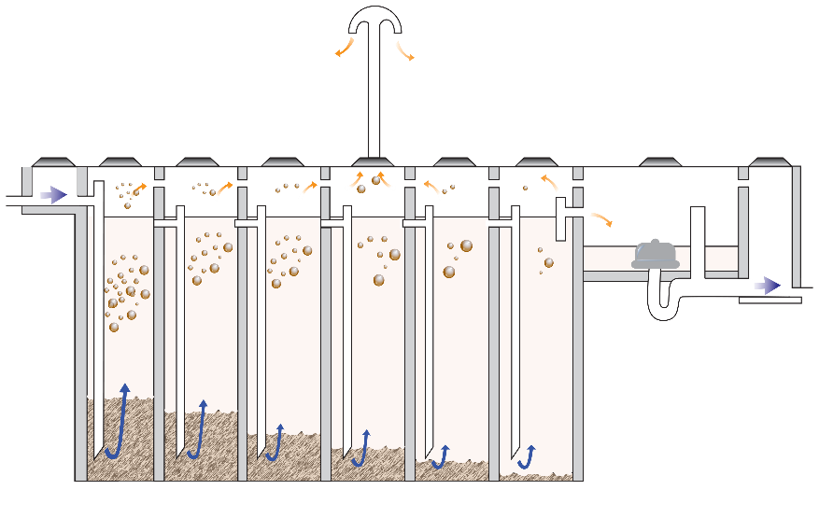
3
Anaerobic Baffled Reactor (Secondary treatment)
Biological treatment:
from top to bottom (in the down pipes): the effluent is forced through the activated sludge where anaerobic bacterial mass degrades the suspended and dissolved solids
From bottom to top (in the chambers): sludge particles settle against the up-stream of the
effluent, providing intense contact between resident sludge and effluent (increased contact time with active biomass)
Anaerobic digestion: large variety of microorganisms (bacteria and methanogens) that convert complex organic compound into simple molecules like methane and carbon dioxide. The process can be roughly divided into 4 stages: hydrolysis, acidogenesis, acetogenesis and methanogenesis.
The overall simplified reaction is shown in the following equation:
Organic matter → CH4 + CO2 + H2 + NH2 + H2S
Methane
Carbon dioxide
Dihydrogen
Amidogen
Hydrogen sulfide
Treatment performance ranges from 65 to 90% BOD removal

Slide 5
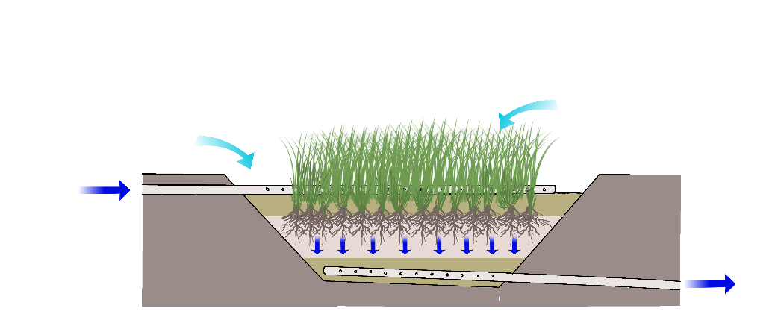
4
Vertical Flow Constructed Wetland (Tertiary treatment)
O2
O2
Oxygen enters the filter media via:
The resting time in between the discontinuous dosage feeding
The macrophytes which transfer oxygen from the atmospheric air through the rhizomes and roots
Polishing step (removal of remaining solids)
Mechanical filtering: the suspended solids are removed through physical filtration and sedimentation
Chemical adsorption: Phosphorus co-precipitates with iron, aluminium and calcium compounds located in the root-bed medium
Biological conversion: aerobic and anaerobic microorganisms facilitates the decomposition of organic matter and enable nitrification and subsequent denitrification to release nitrogen as gas to the atmosphere
Removal of harmful bacteria and viruses through natural predation occurring in the biofilm growing on the filter media
Treatment performance ranges from 90 to 95% BOD
Reduction of infective organisms over 95%
Nitrogen removal limited to 30 to 40%

Slide 6
Nitrification | Biological conversion of ammonium to Nitrate. Nitrifiers (aerobes bacteria) work strictly under aerobic conditions (DO > 1.0 mg/L)
Denitrification | Biological reduction of Nitrate to Nitrogen gas. Heterotrophic (facultative) bacteria get their oxygen by taking dissolved oxygen out of the water or by taking it off nitrate molecules. Denitrification occurs when oxygen levels are depleted and nitrate becomes the primary oxygen source for microorganisms.
NH₄
Ammonia
Nitrosomonas
NITRIFICATION
(aerobic conditions)
NO₂⁻
Bacillius
Pseudomonas
Clostridium
Escaped into the atmosphere
Nitrite
Nitrobacter
NO₃⁻
NO₂⁻
NO
N₂O
N₂
Nitrate
Nitrite
Nitric Oxide
Nitrous Oxide
Nitrogen
DENITRIFICATION
(anoxic conditions)

Slide 7
5
Sludge Drying Beds (Sludge treatment)
The drying process is based on two principles:
Percolation of the leachate through sand and gravel (50 to 80% of the total volume)
Evaporation of the bound water fraction of the sludge (20 to 50% of the total volume)
Sludge partly stabilised
Dehydration kills pathogens through UV radiation, heat and absence of water
Leachate must be treated further
6
Composting area (Sludge treatment)
Remove the remaining pathogens of the sludge during the peak of temperature (65°C)
Add a fertilizing value to the compost (Nitrogen, Phosphorus and Carbon)
In agriculture, a thin layer of compost applied to crops increases microbial activity, helps the soil to retain water, improves the soil’s structures and provide plants with essential nutrients.

